Slide 1
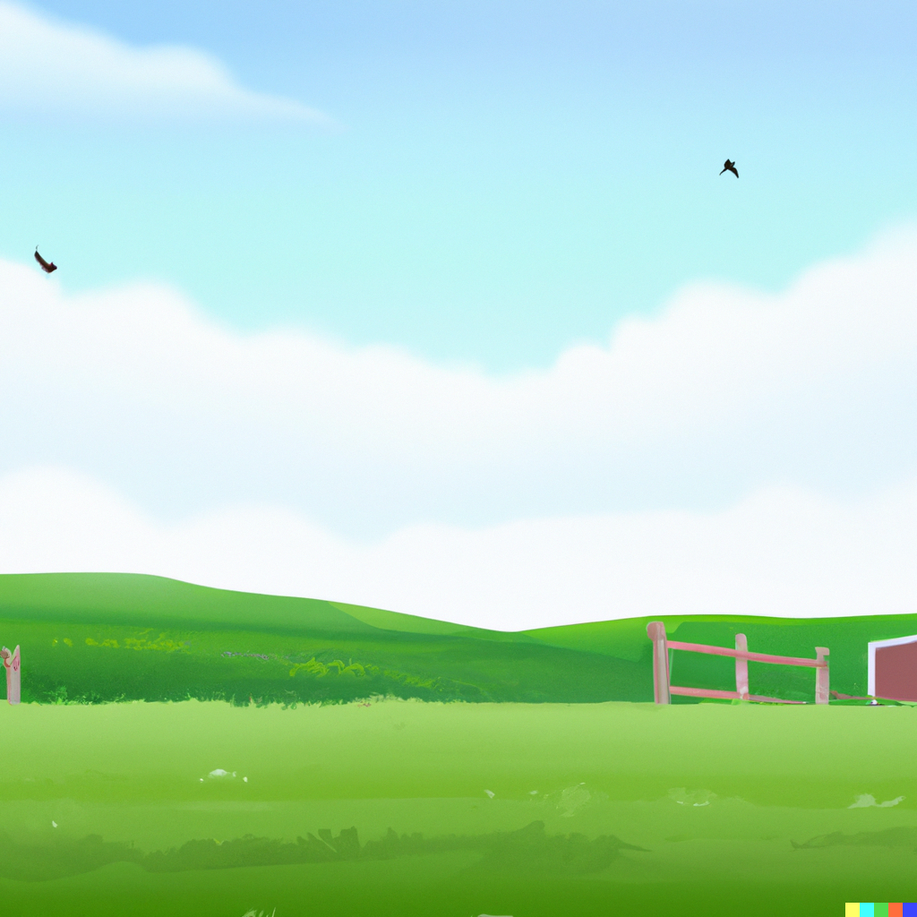

Old McDonald is upset to see his empty farm, as his farm animals ran away.
Help the Old McDonald to collect the escaped animals

Slide 2




Question 1/5
Identify the voice and catch the farm animal.
Pig
Cow
Duck
Wrong Answer.
Try Again!

Slide 3
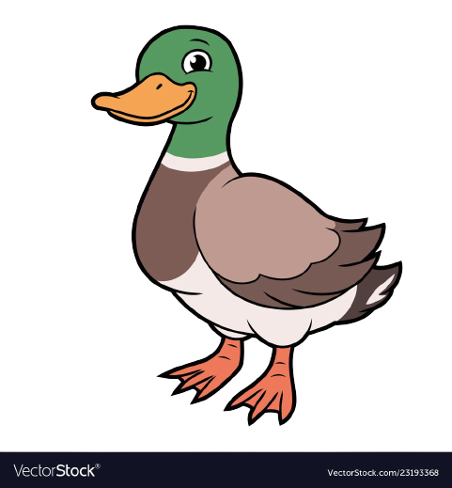
Question 2/5
Identify the voice and catch the farm animal.
Horse
Pig
Chick
Wrong Answer.
Try Again!

Slide 4
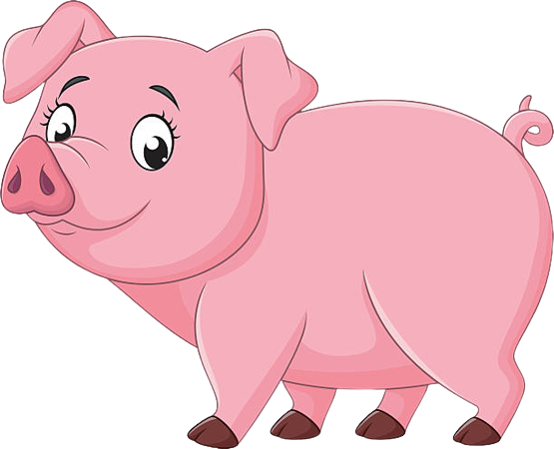
Question 3/5
Identify the voice and catch the farm animal.
Horse
Sheep
Hen
Wrong Answer.
Try Again!

Slide 5
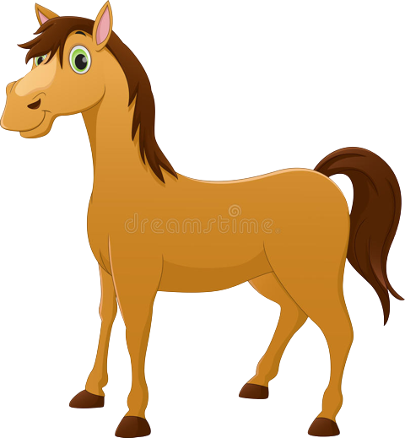
Question 4/5
Identify the voice and catch the farm animal.
Duck
Hen
Cow
Wrong Answer.
Try Again!

Slide 6
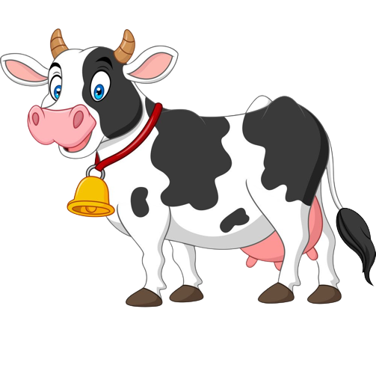
Question 5/5
Identify the voice and catch the farm animal.
Duck
Sheep
Cow
Wrong Answer.
Try Again!

Slide 7
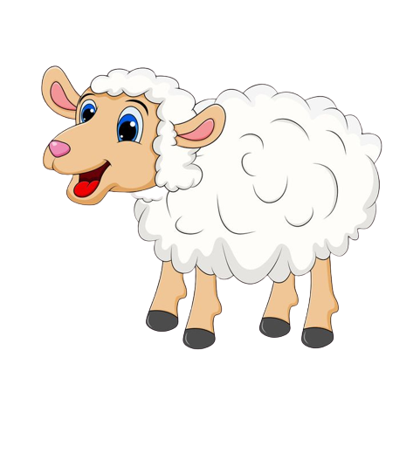
Wow! You caught all the farm Animals.
Thanks for helping Old McDonald.

